Slide 1
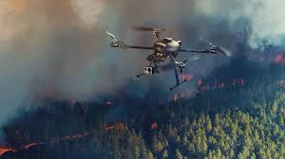
Use Of Drones in Natural Calamity

Slide 2
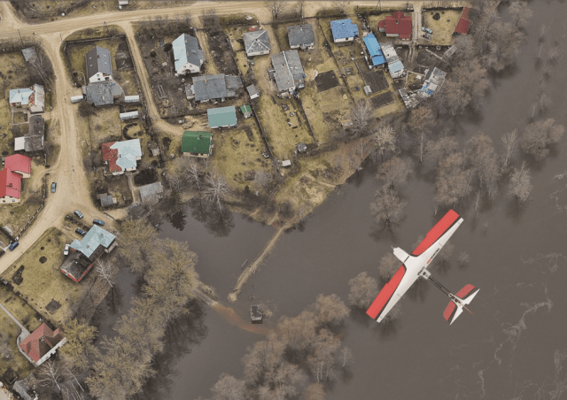
Helps in 3D imaging of affected area using fusion sensors
Really Handy During a Water Calamity

Slide 3
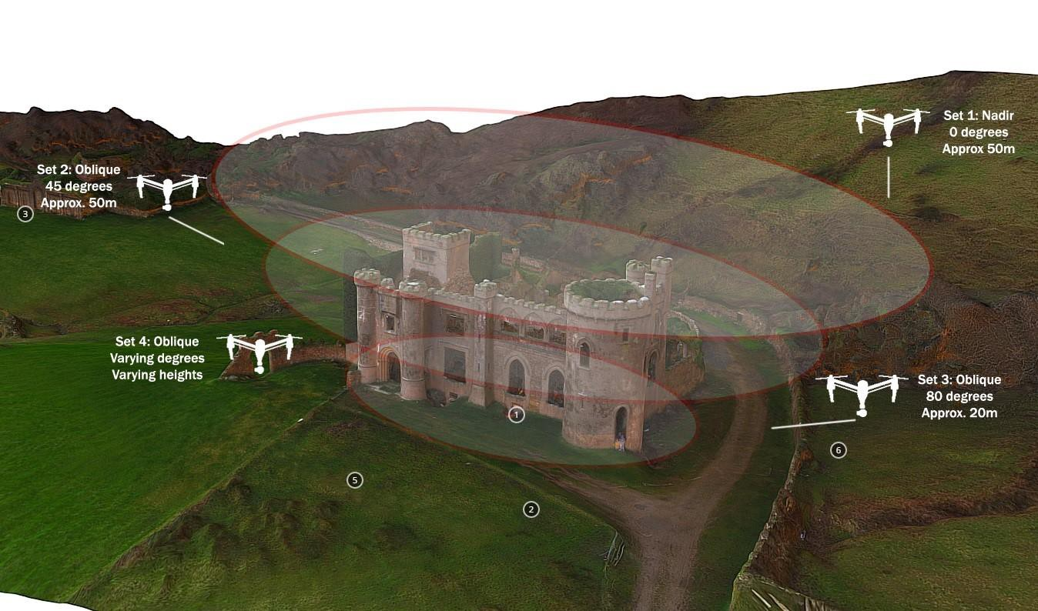

Slide 4
Provides pick and transport service of supplies from relieve camps to victims
Does the surveillance and identifies the optimal routes for the rescue team to reach the victims

Slide 5
Advantages
Quick response time by the rescue team
Providing supplies to people stuck in remote places who can’t access the relief camps
Locating victims efficiently without wasting much time
Perfect understanding of the region affected by calamity thus avoiding mistakes in rescue operations

Slide 6
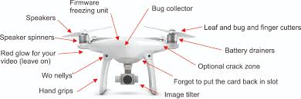

Slide 7
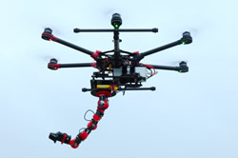
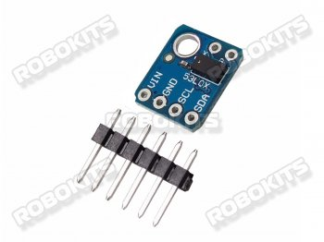
LiDAR

